Slide 1


Slide 2
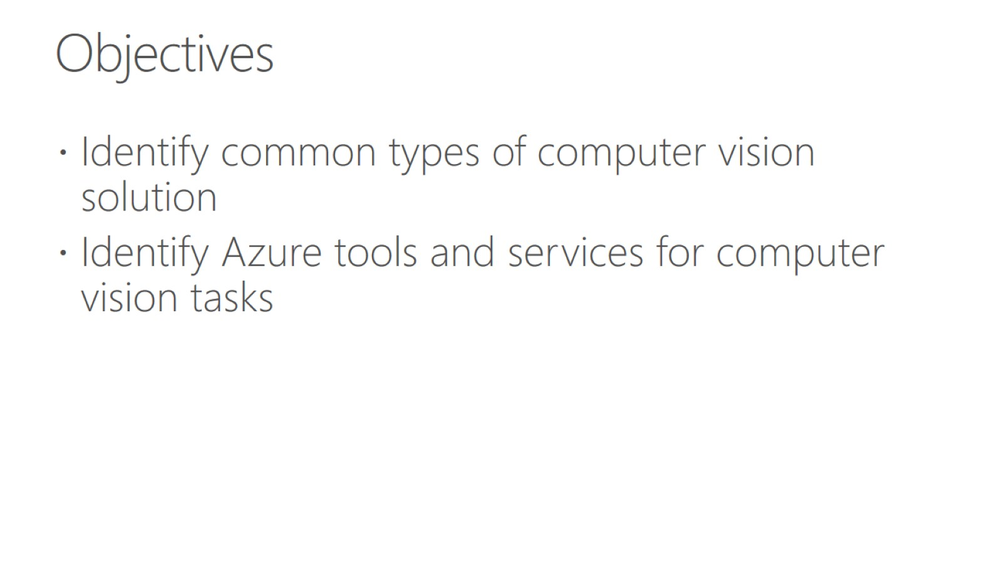
Objectives

Slide 3
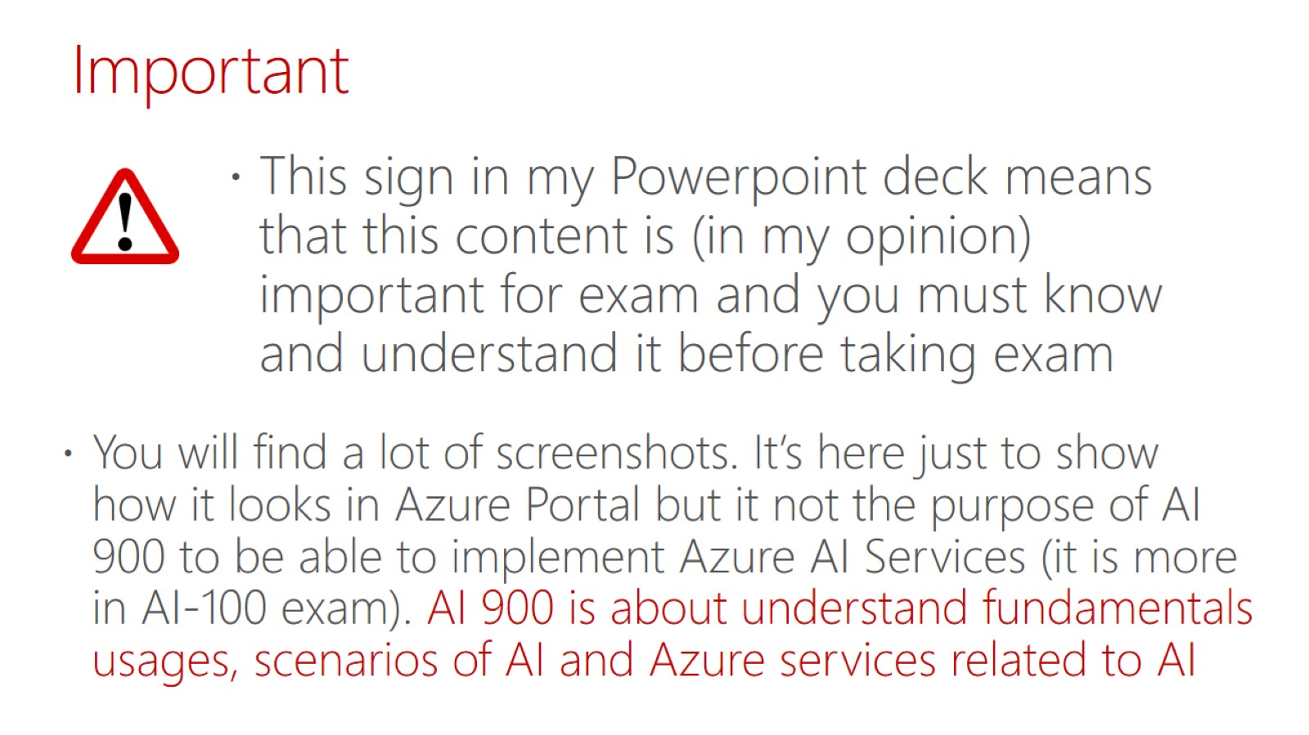
Important

Slide 4
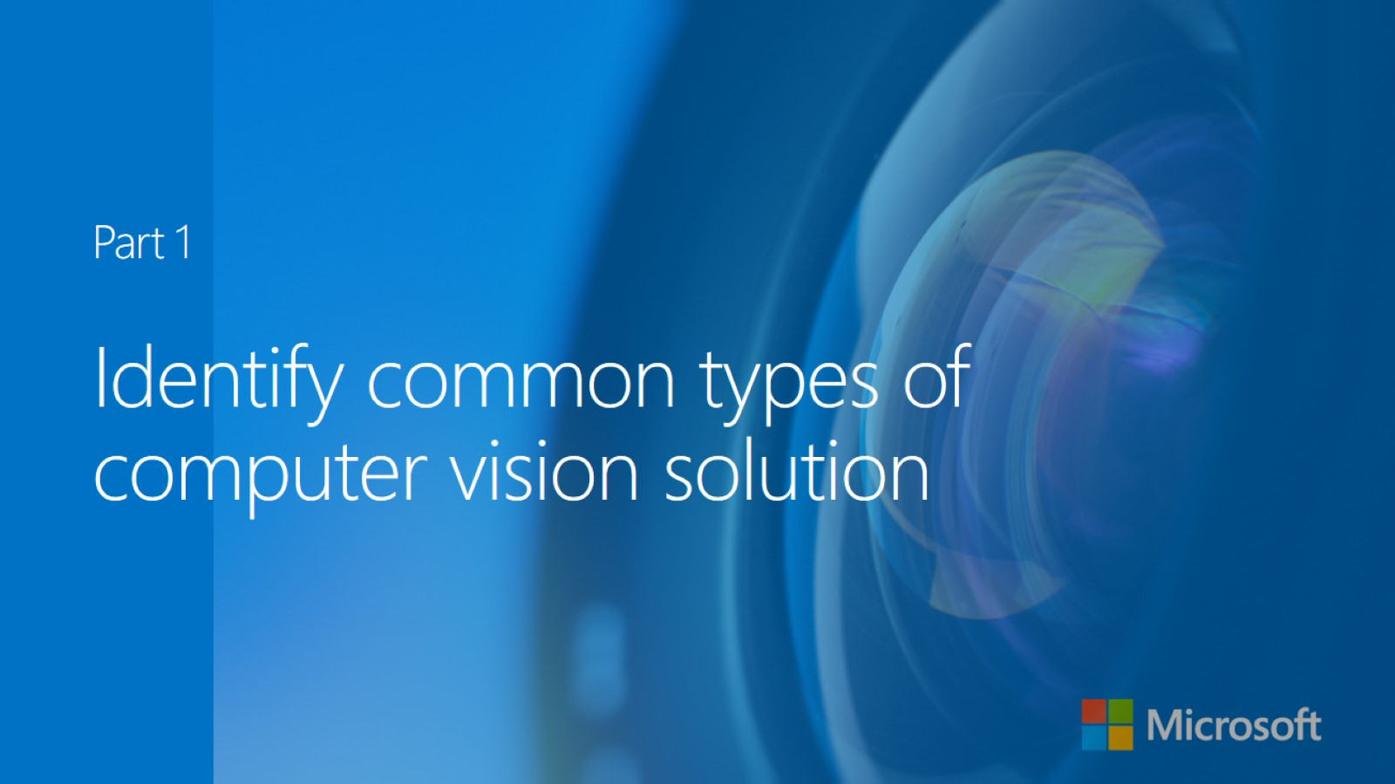

Slide 5
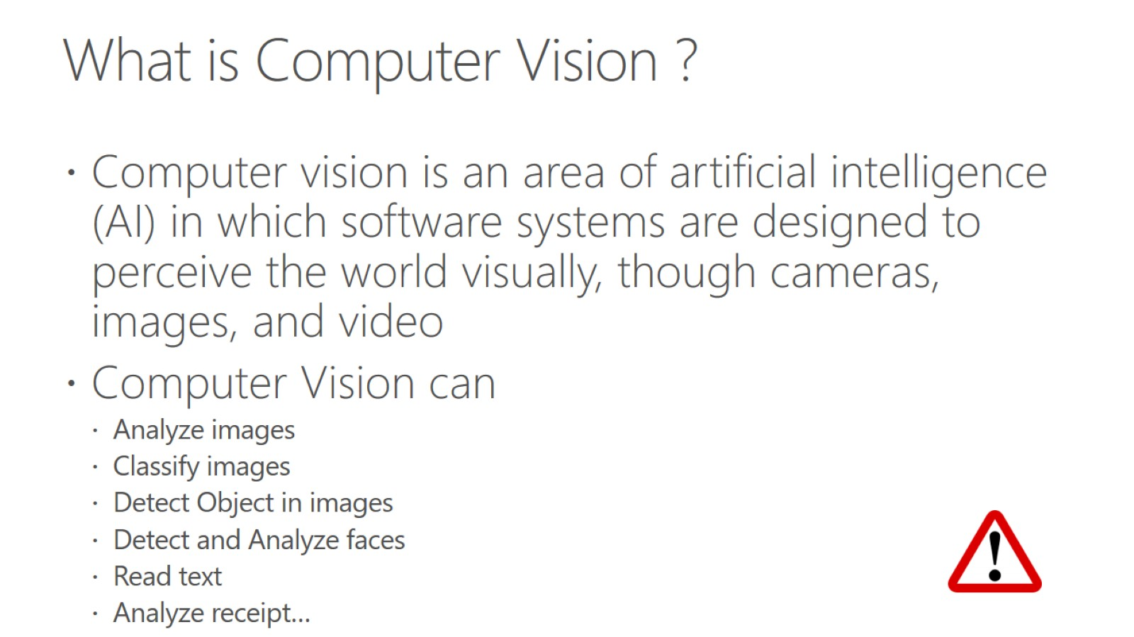
What is Computer Vision ?

Slide 6
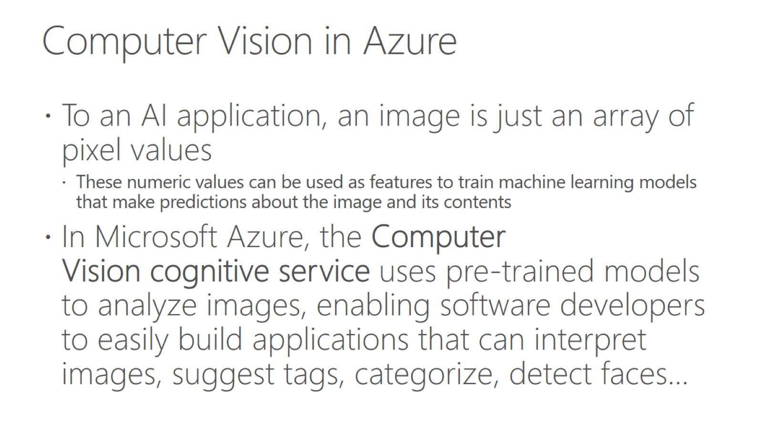
Computer Vision in Azure

Slide 7
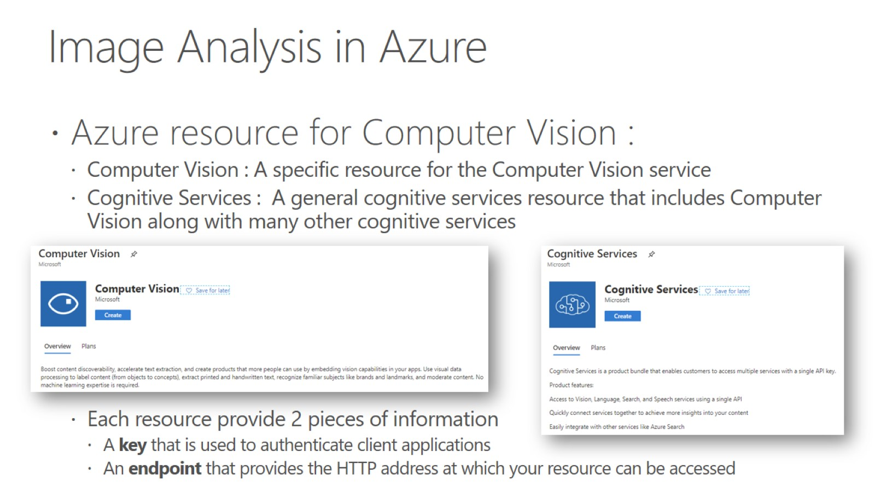
Image Analysis in Azure

Slide 8
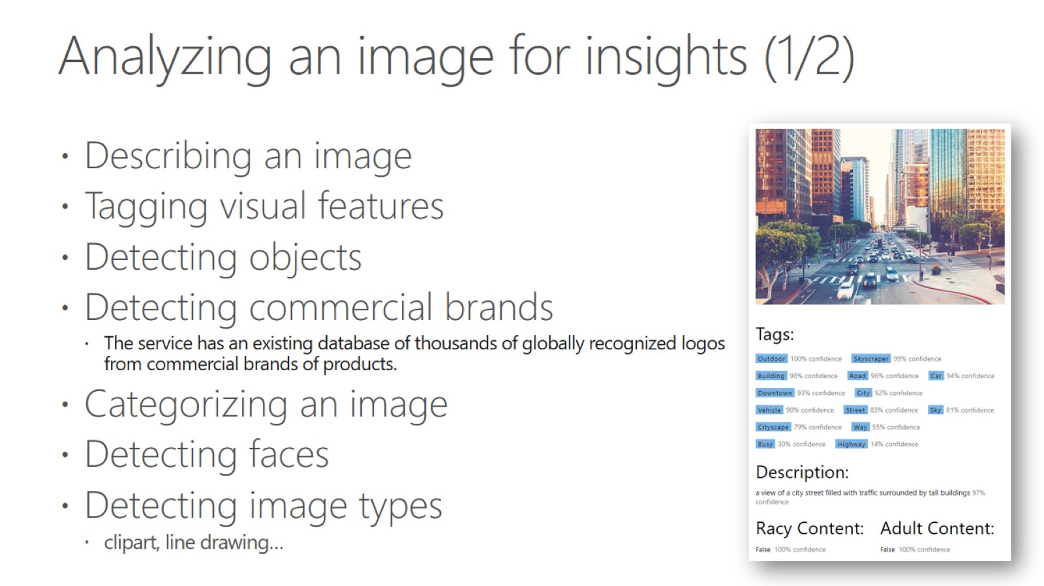
Analyzing an image for insights (1/2)

Slide 9
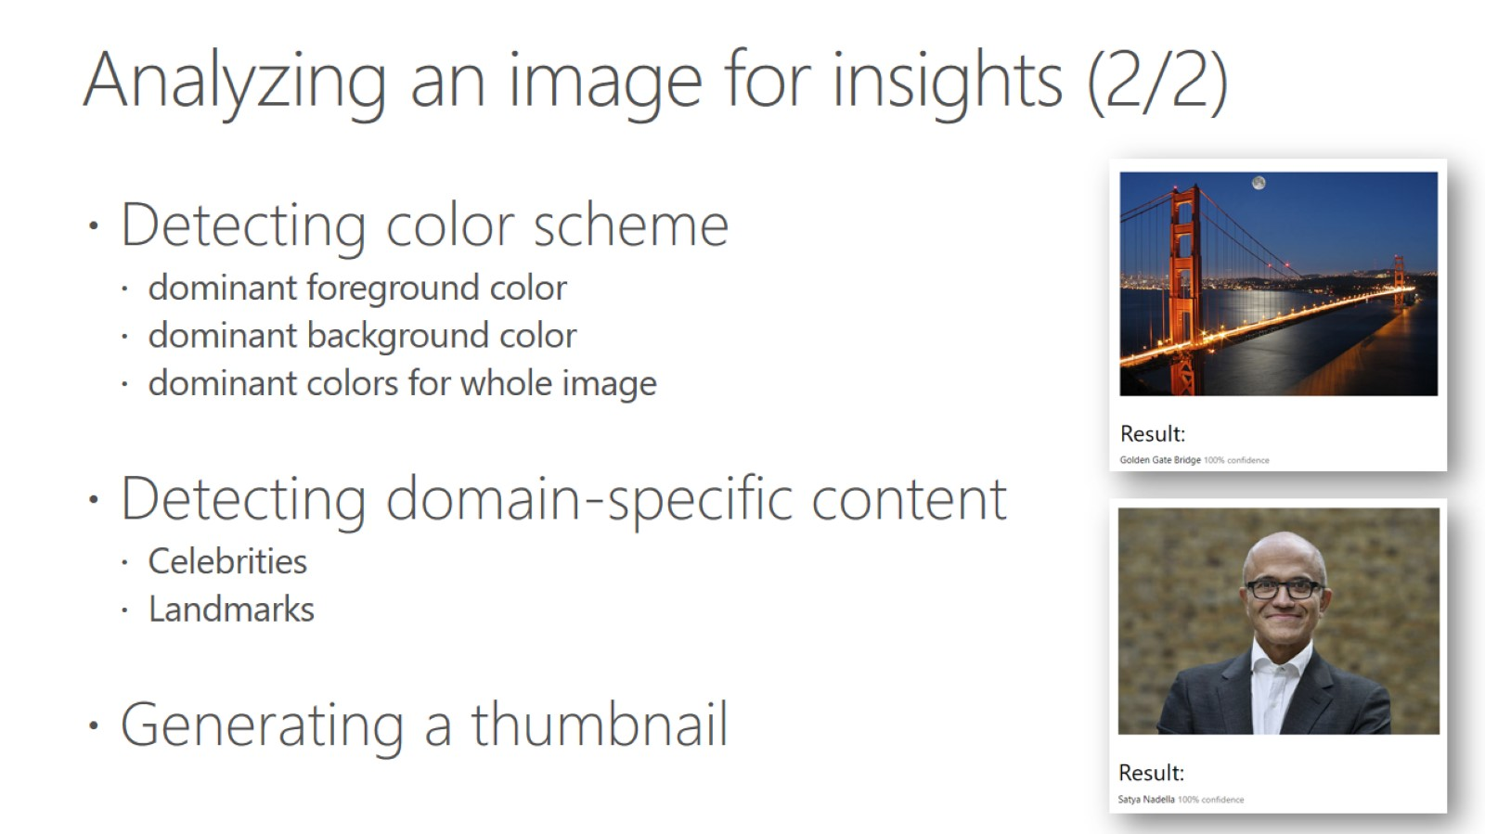
Analyzing an image for insights (2/2)

Slide 10
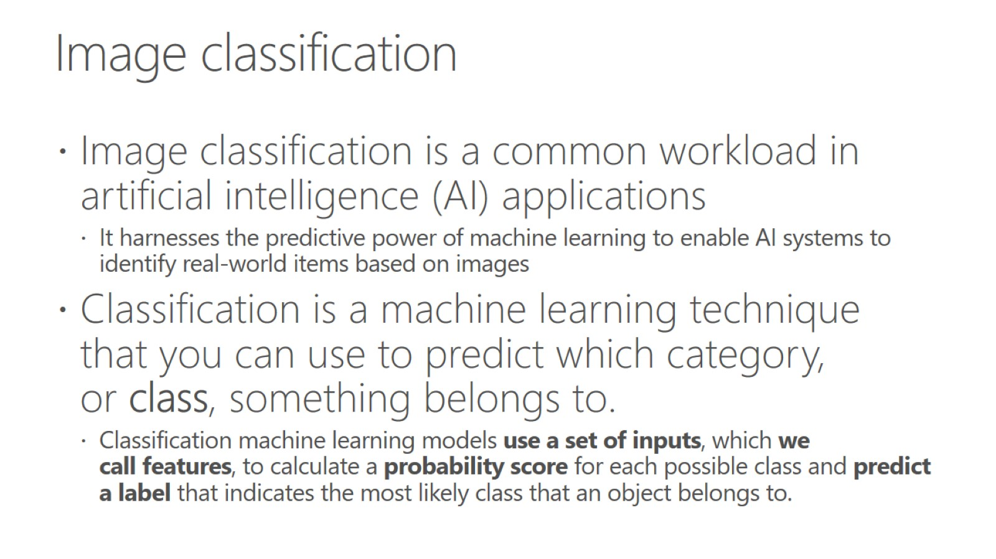
Image classification

Slide 11
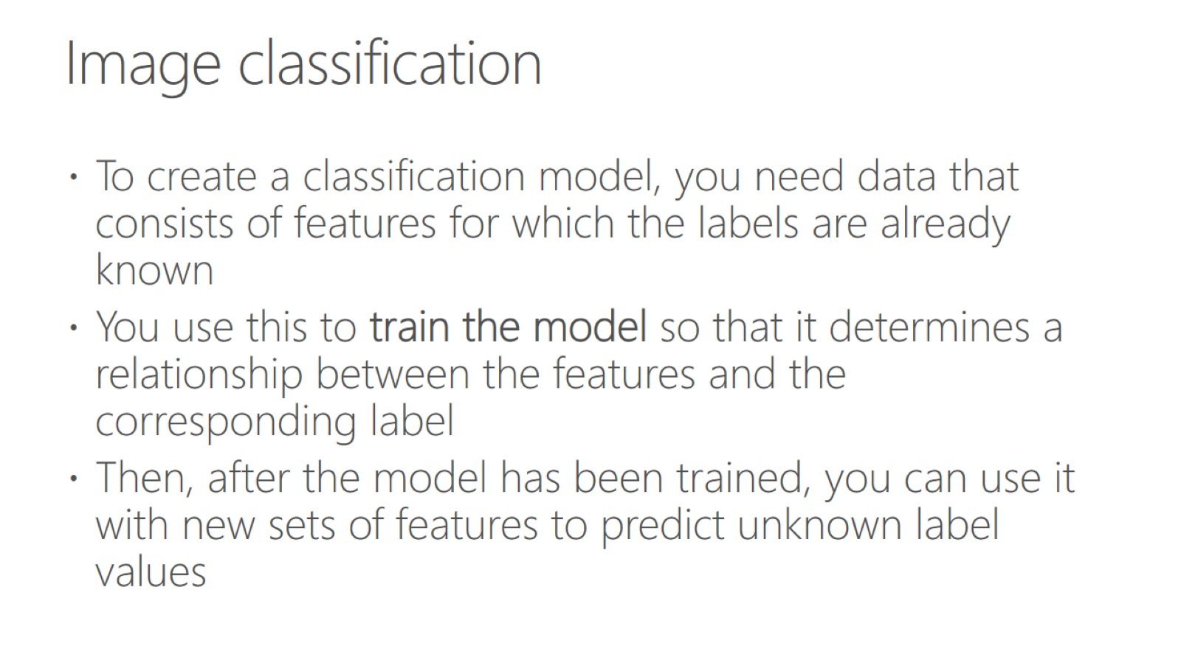
Image classification

Slide 12
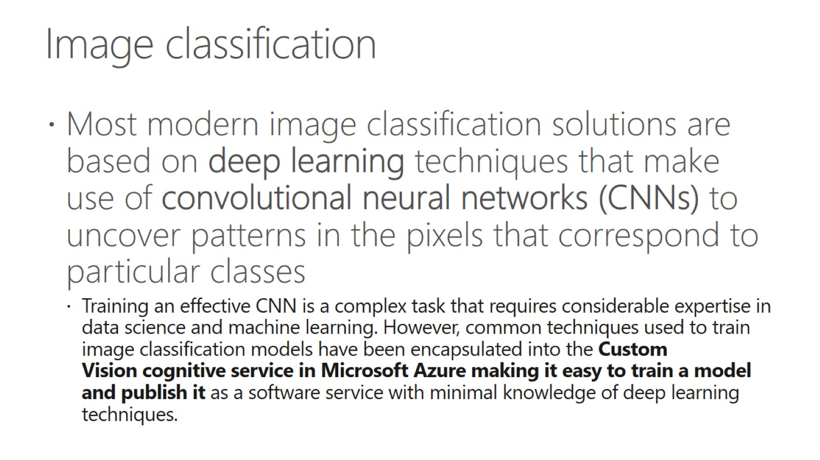
Image classification

Slide 13
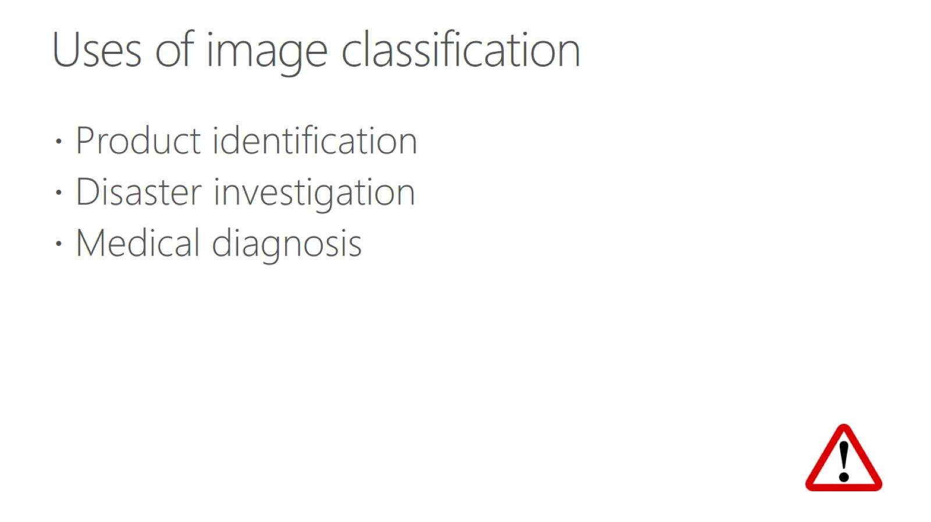
Uses of image classification

Slide 14


Slide 15
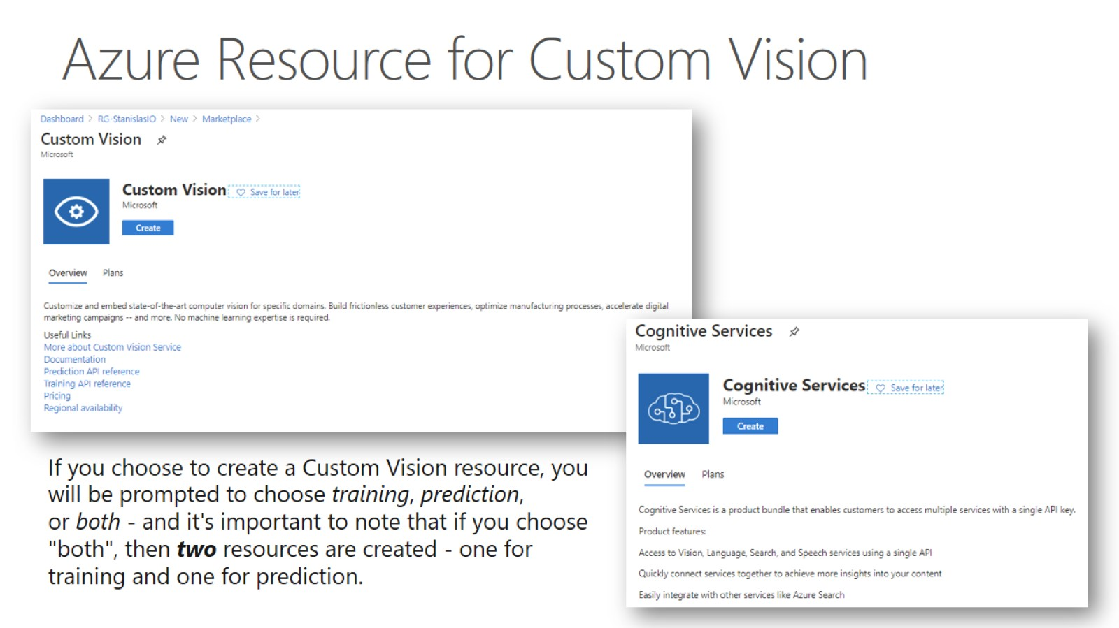
Azure Resource for Custom Vision

Slide 16
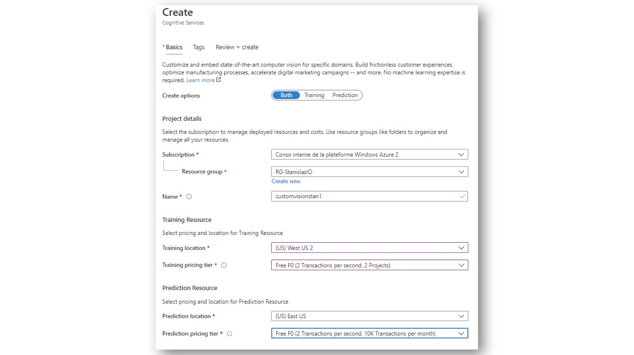

Slide 17
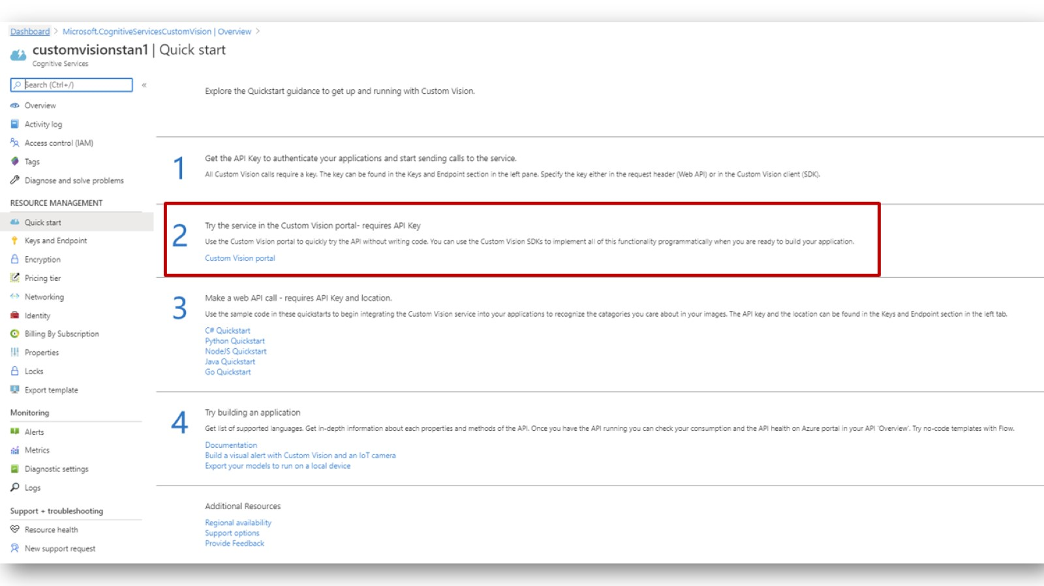

Slide 18
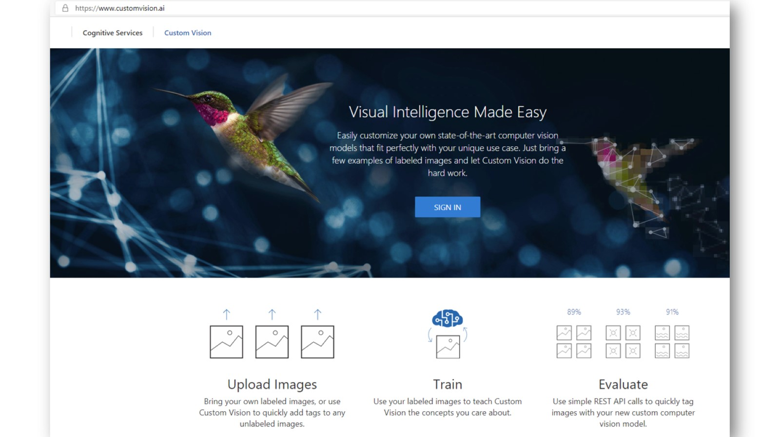

Slide 19
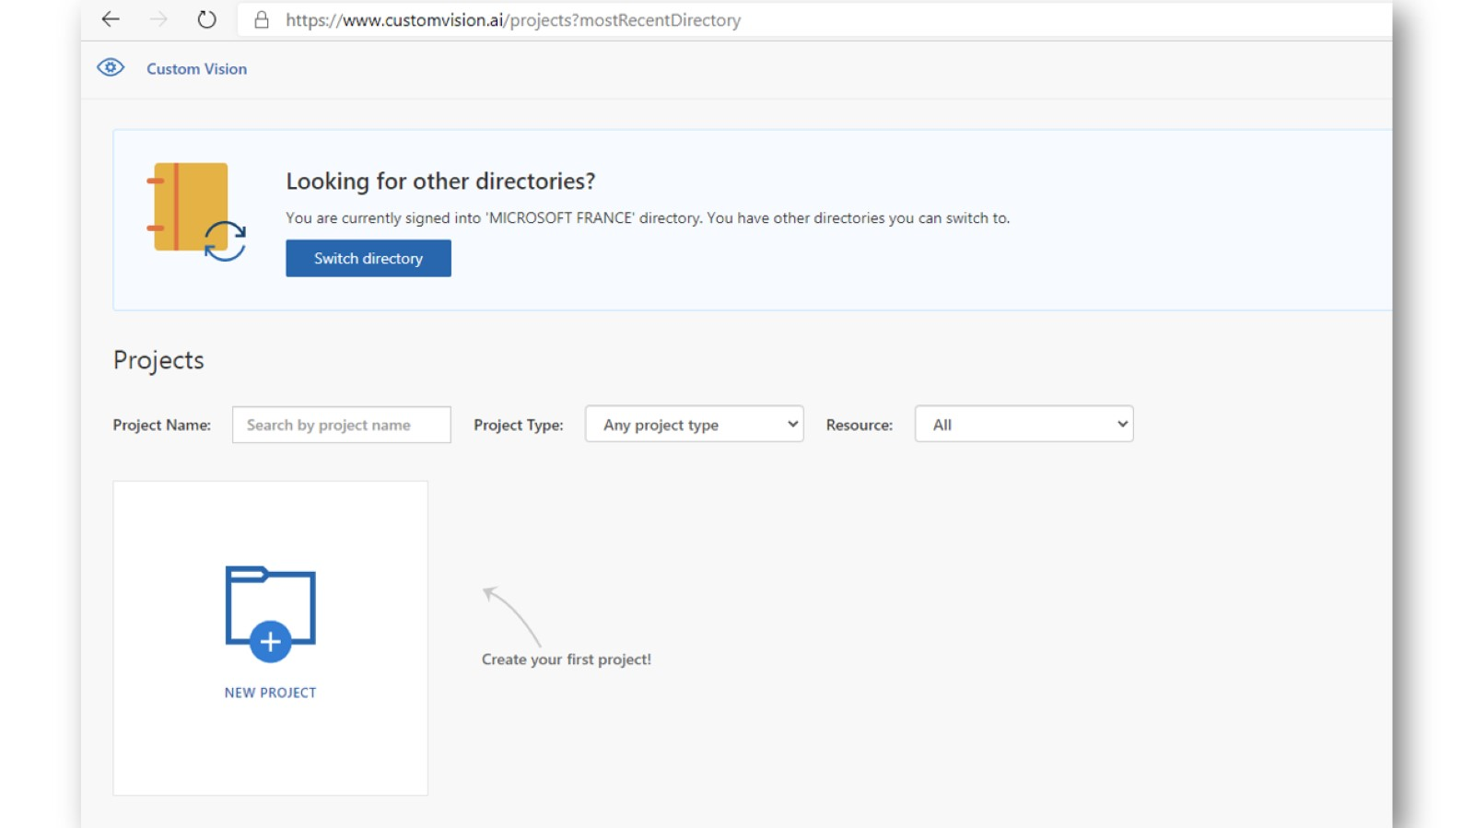

Slide 20
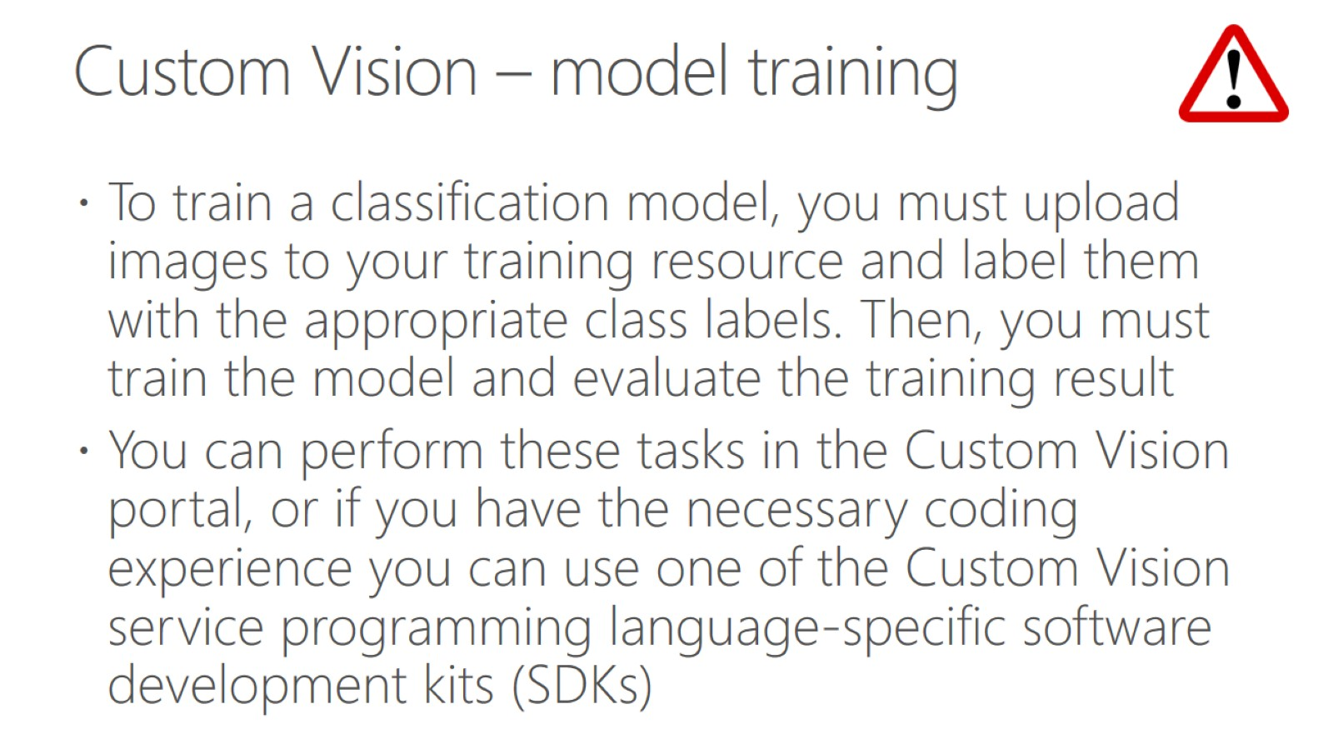
Custom Vision – model training

Slide 21
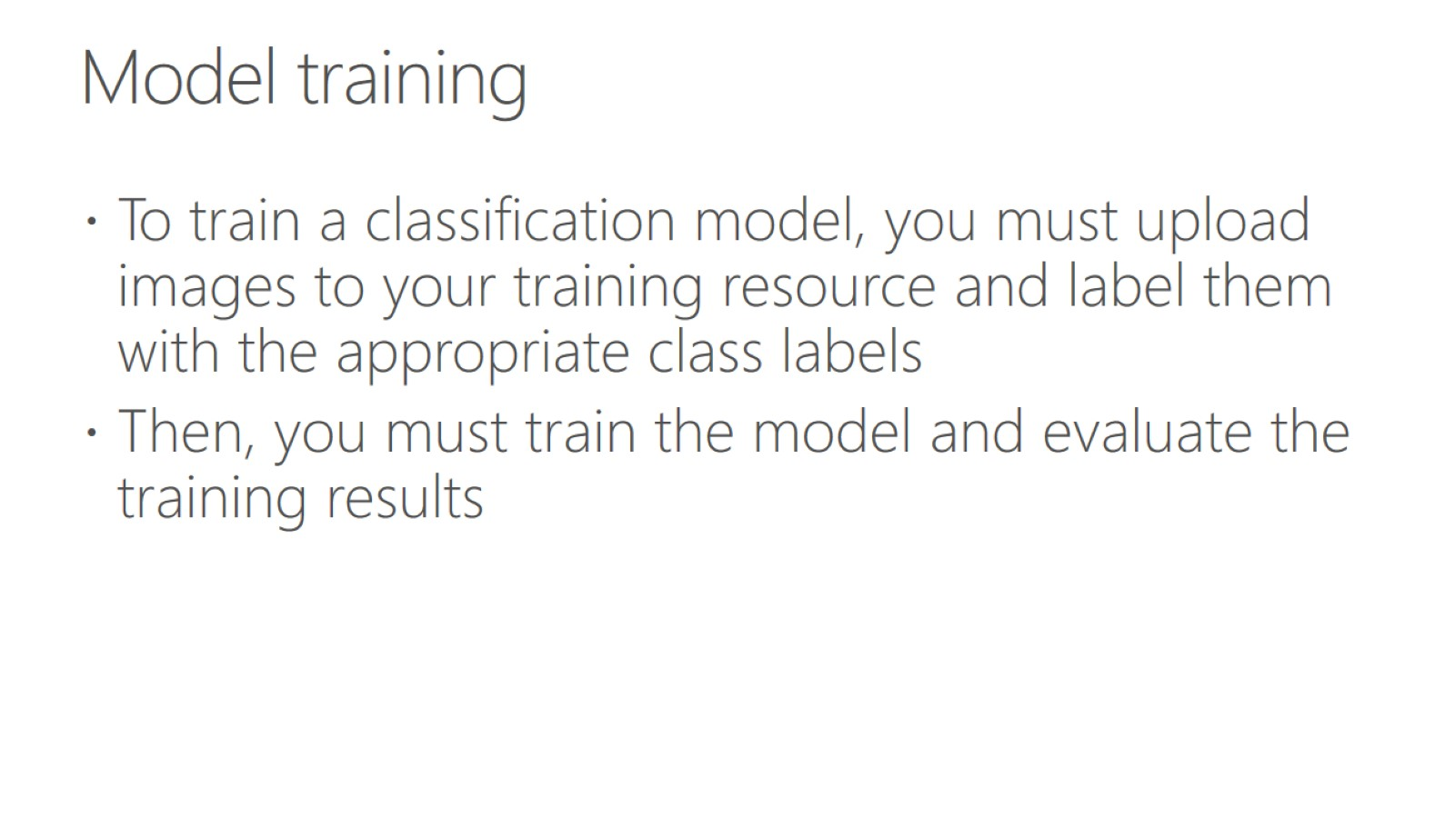
Model training

Slide 22
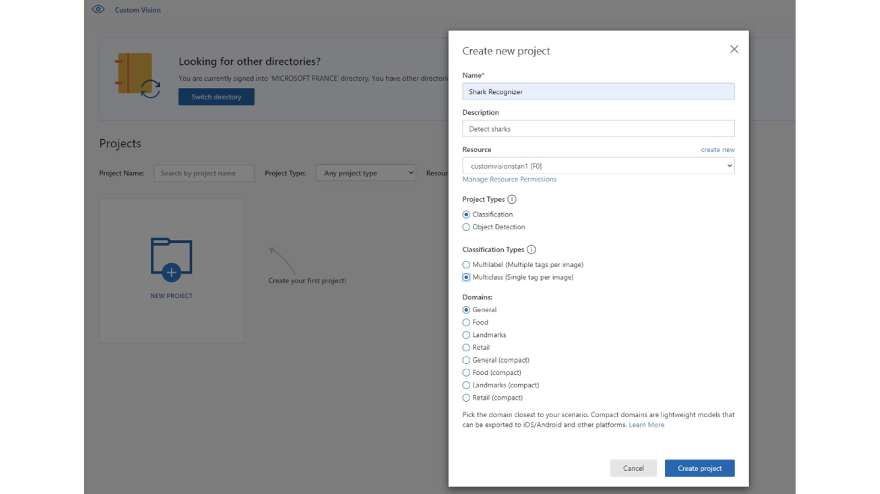

Slide 23
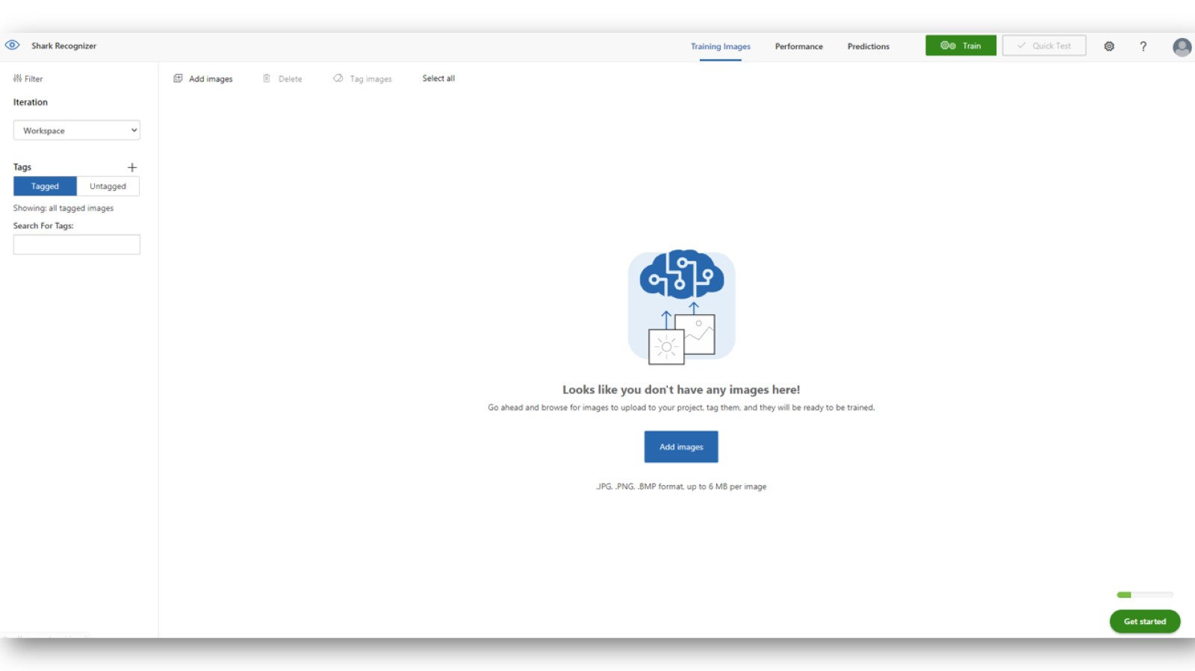

Slide 24
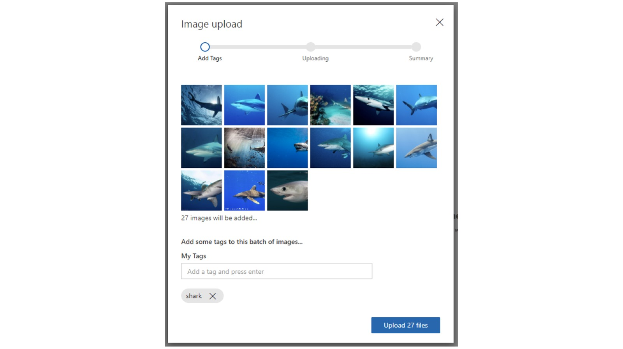

Slide 25
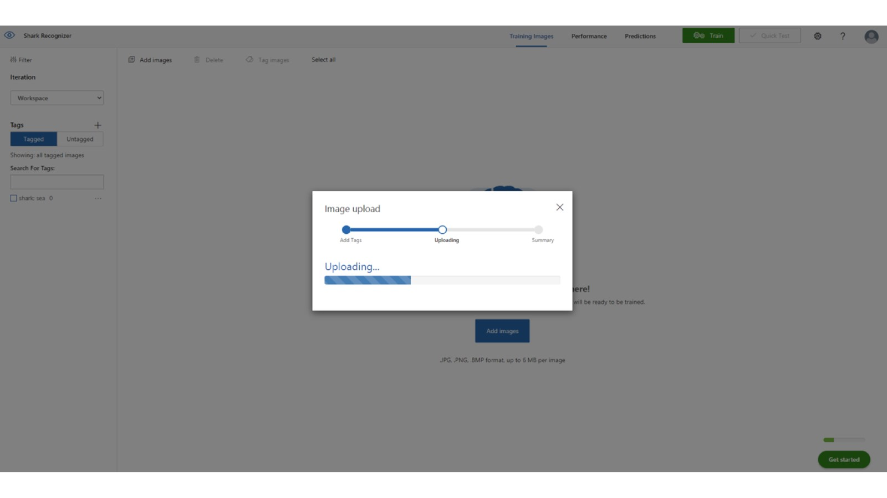

Slide 26
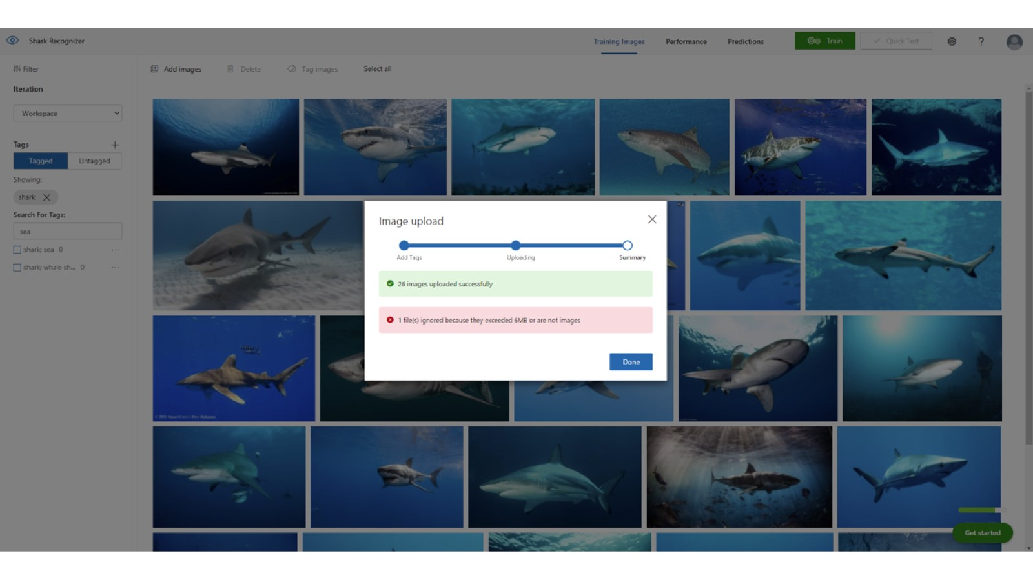

Slide 27
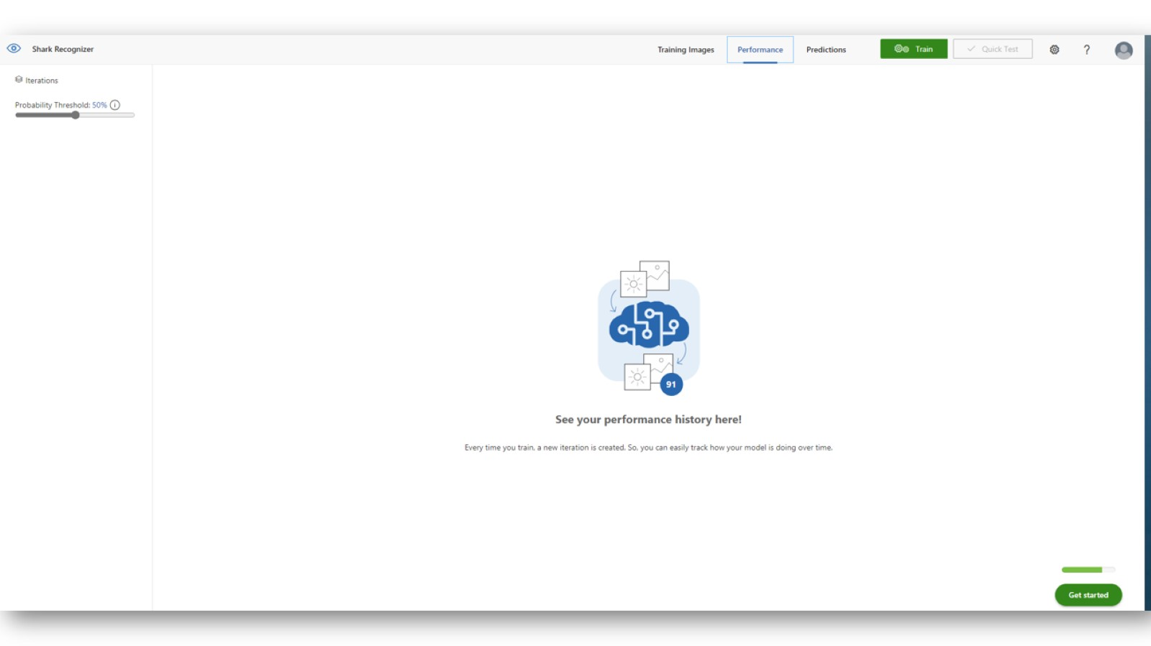

Slide 28
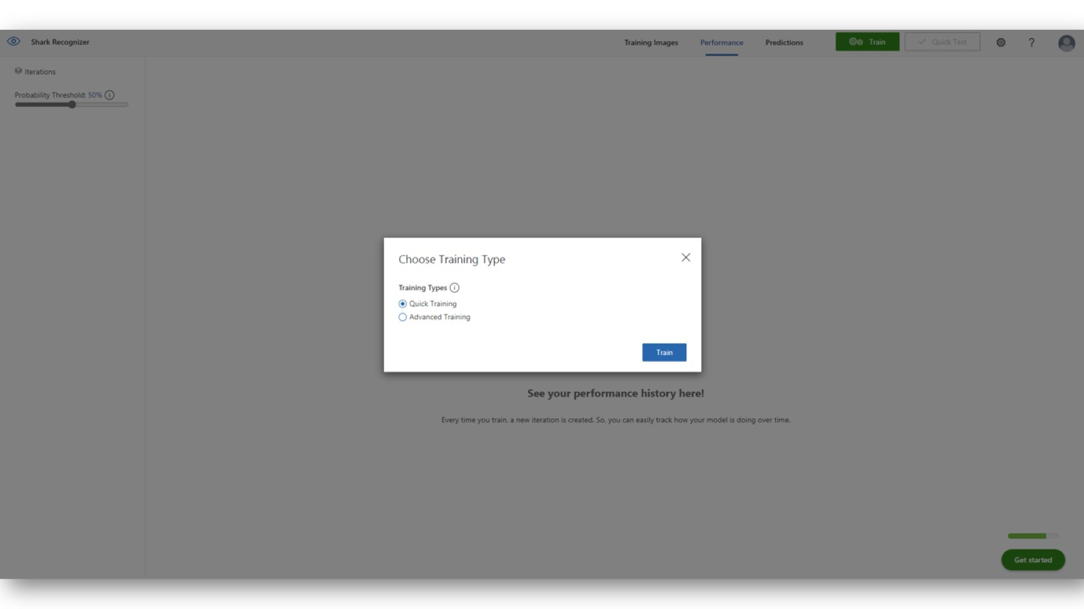

Slide 29
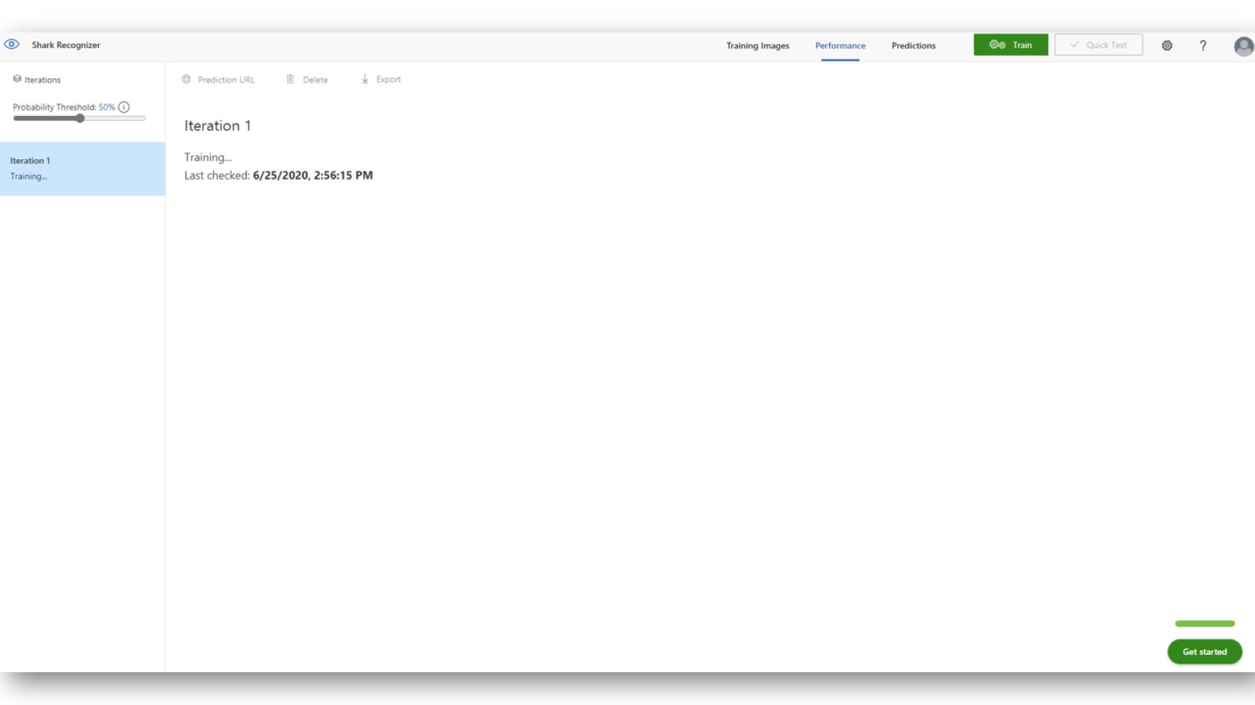

Slide 30
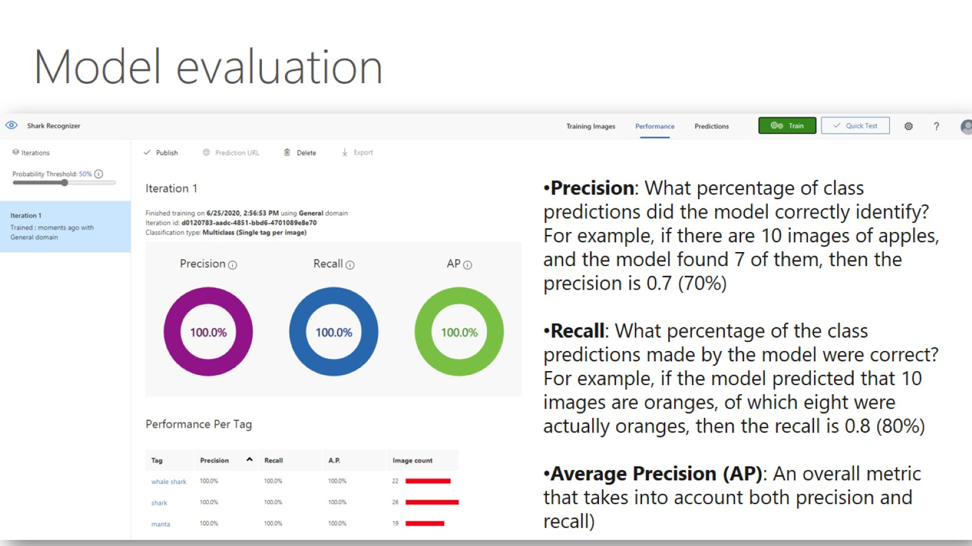

Slide 31
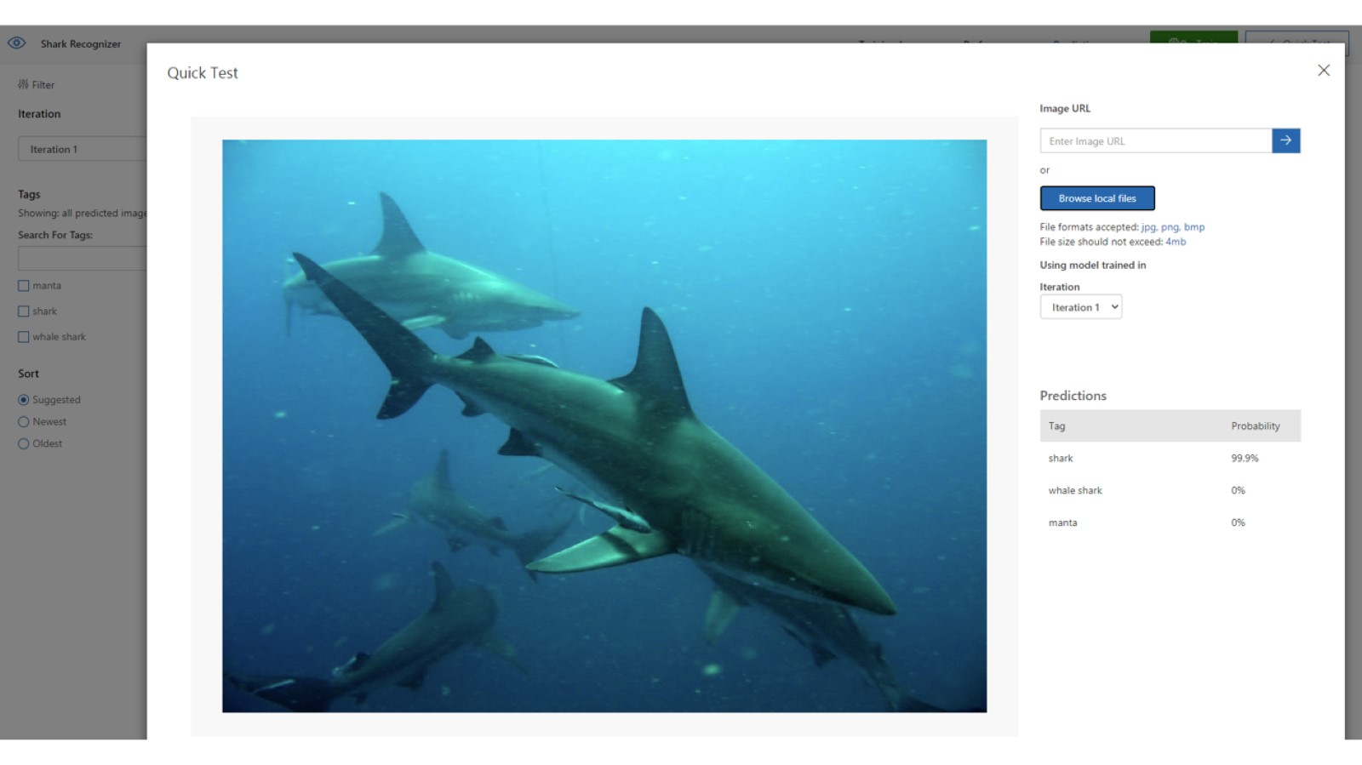

Slide 32
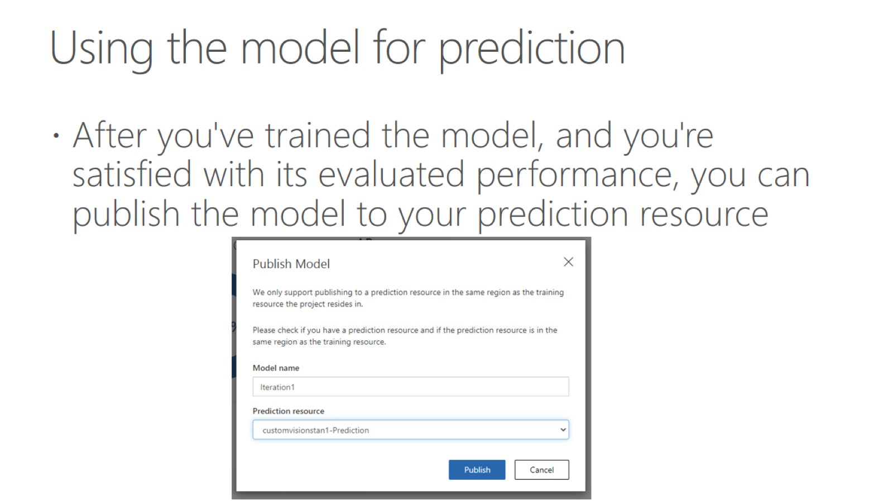
Using the model for prediction

Slide 33
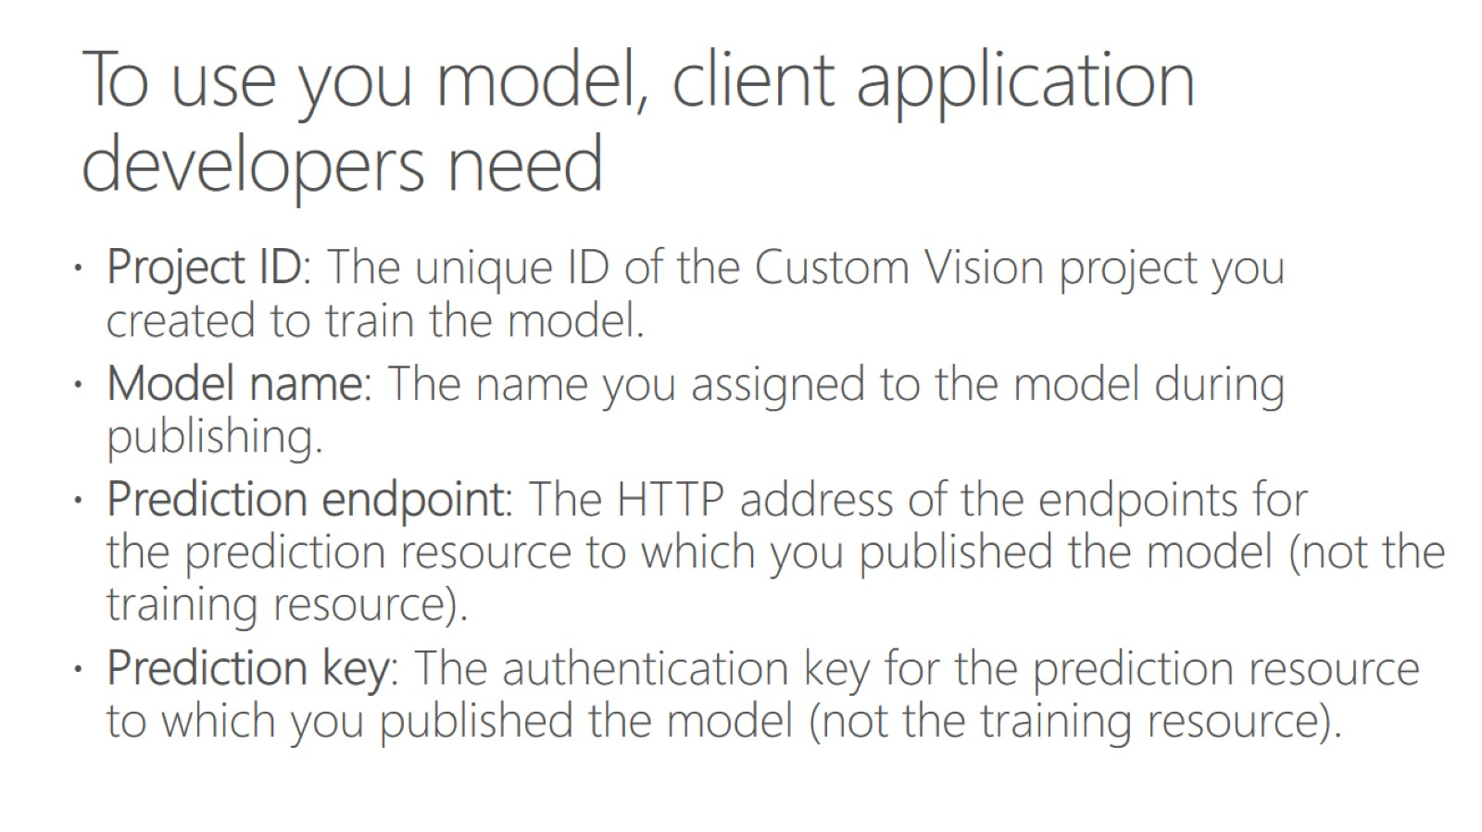
To use you model, client application developers need

Slide 34
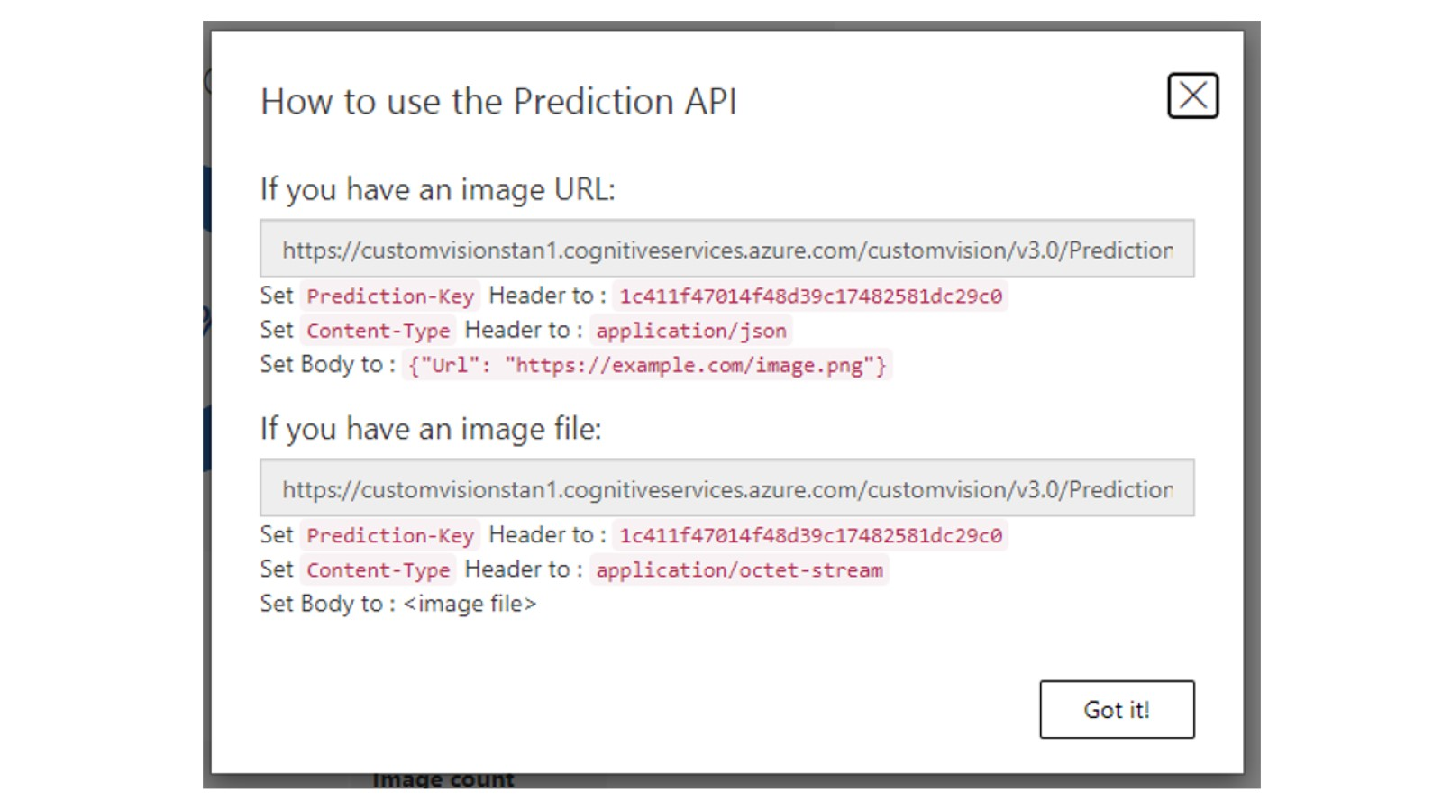

Slide 35
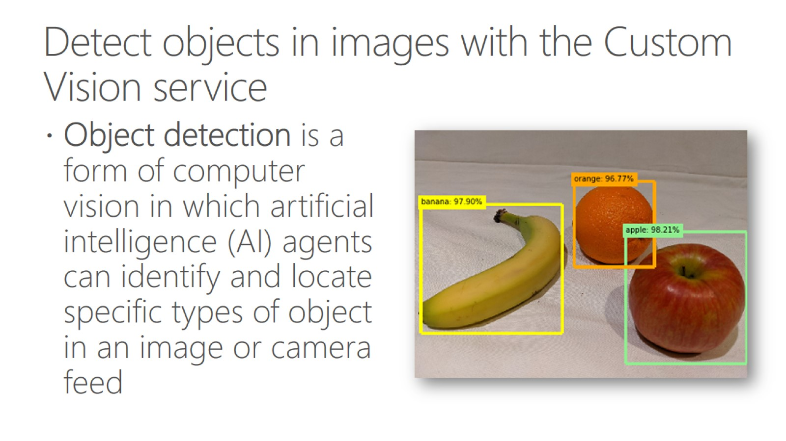
Detect objects in images with the Custom Vision service

Slide 36
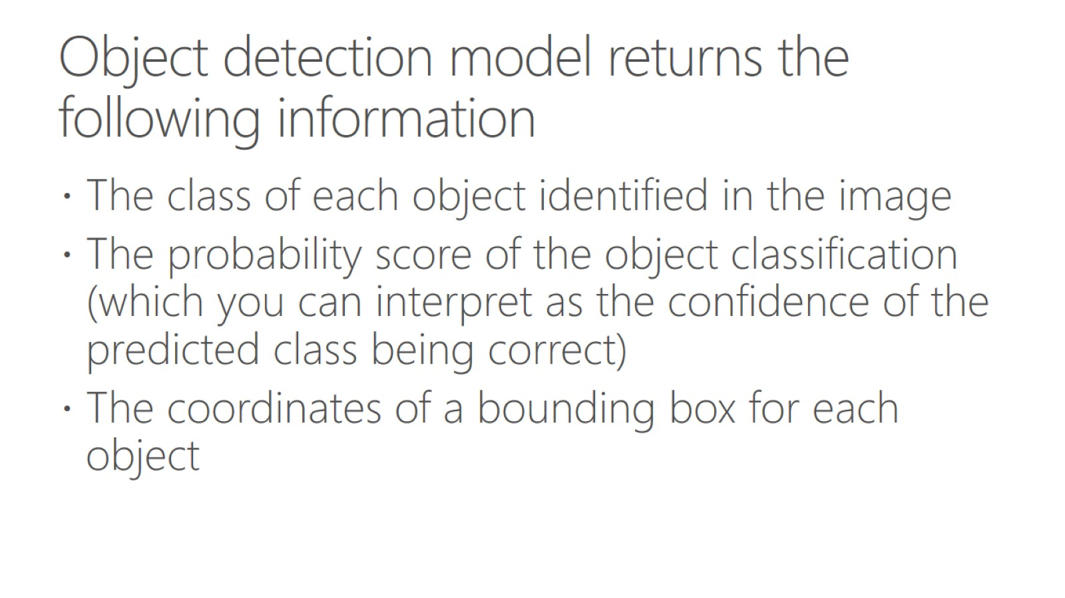
Object detection model returns the following information

Slide 37
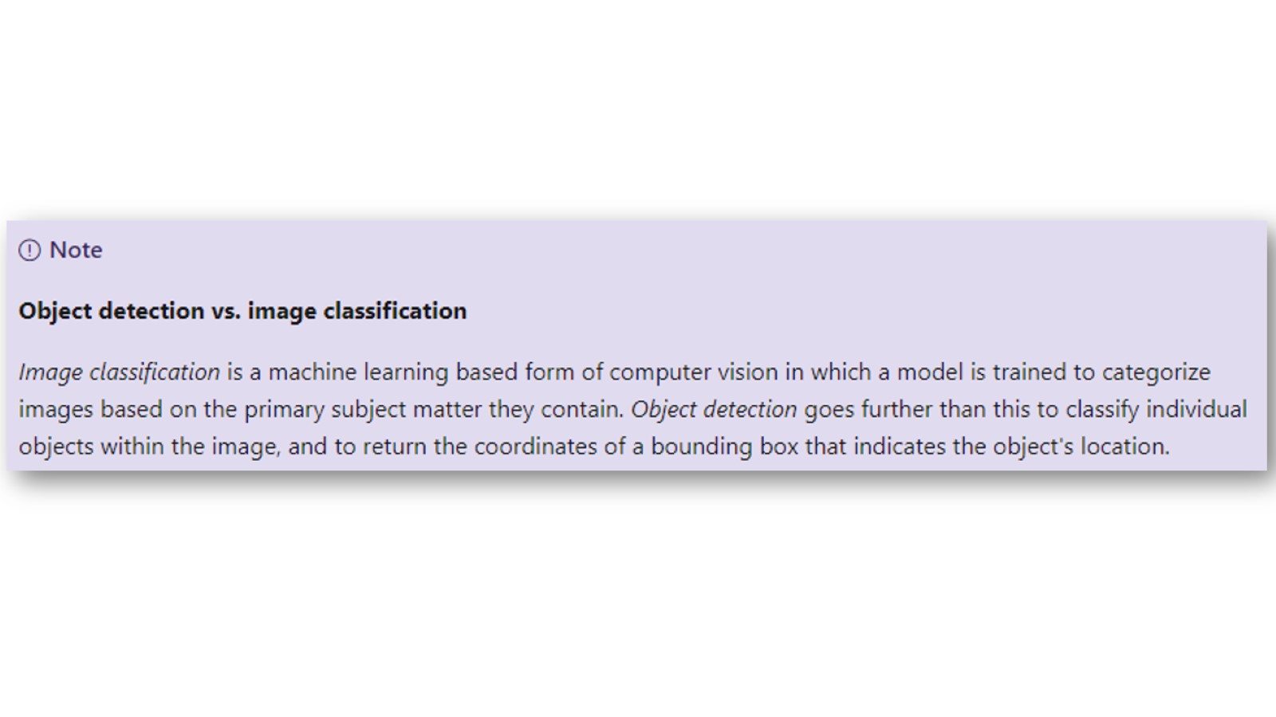

Slide 38
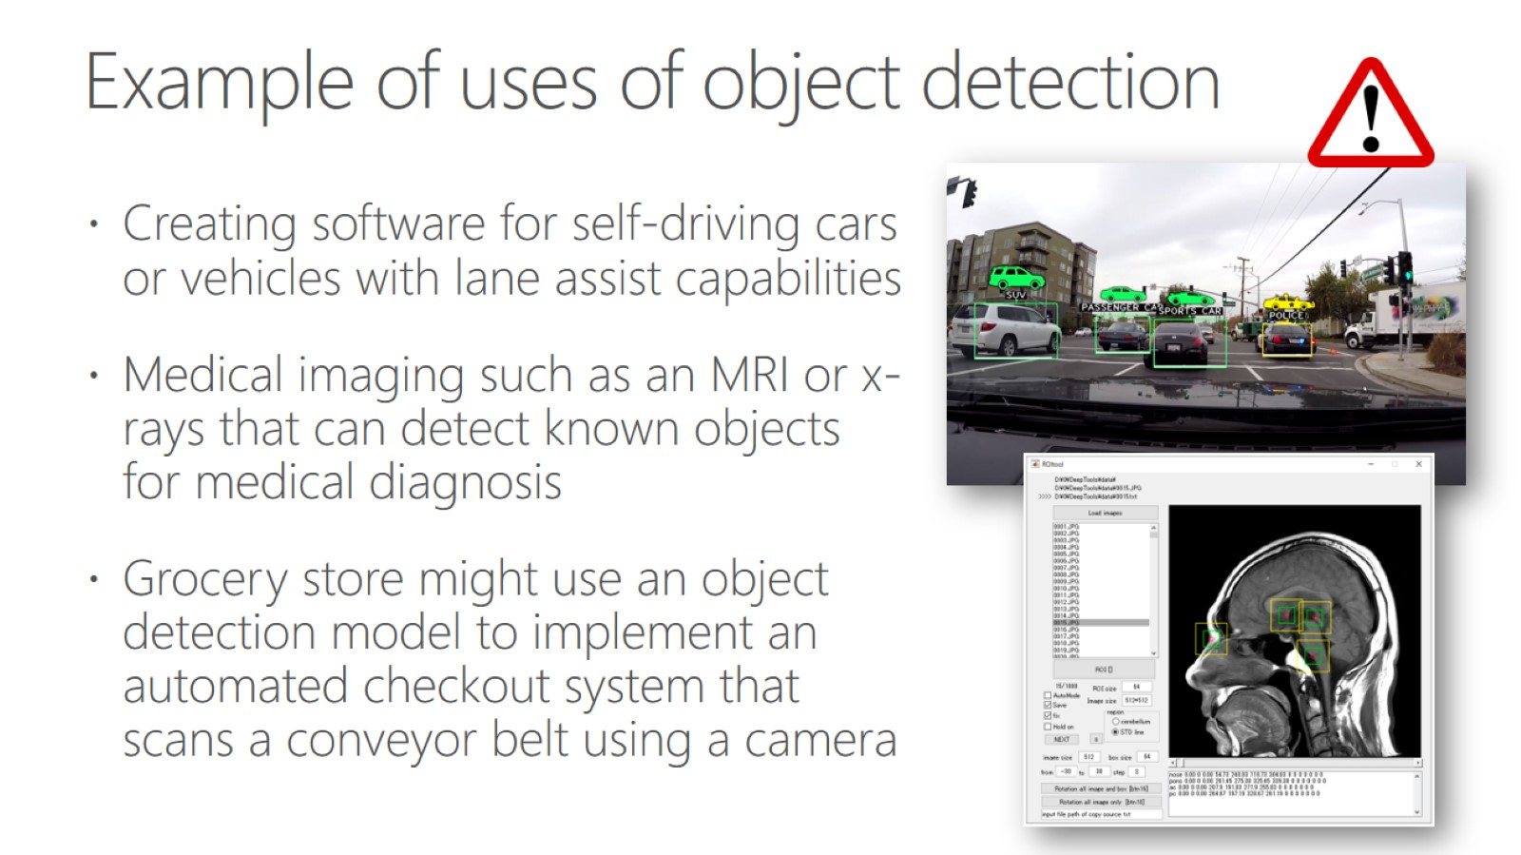
Example of uses of object detection

Slide 39
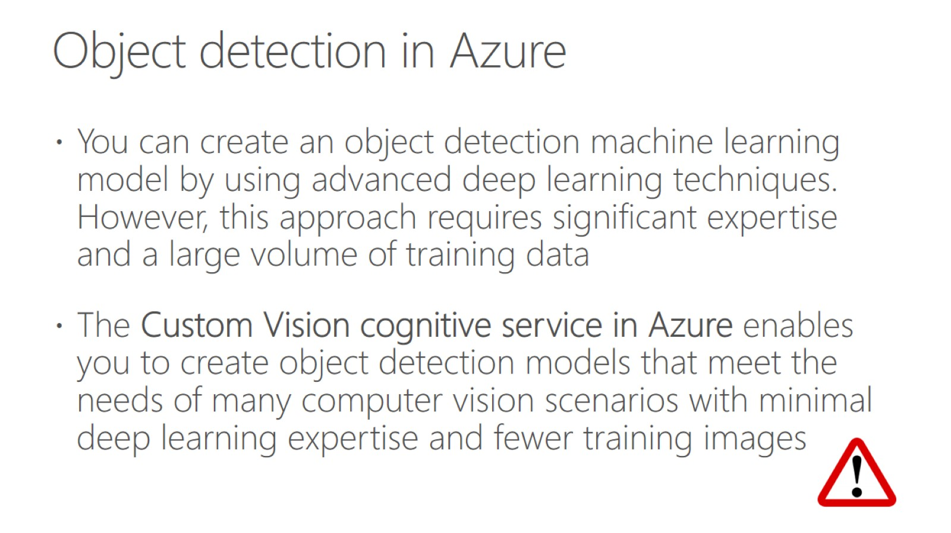
Object detection in Azure

Slide 40
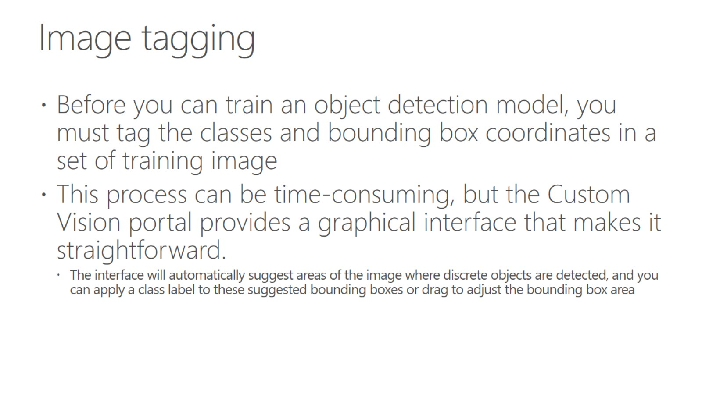
Image tagging

Slide 41
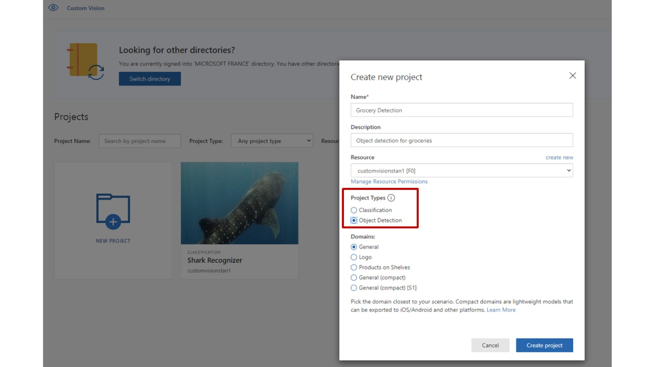

Slide 42
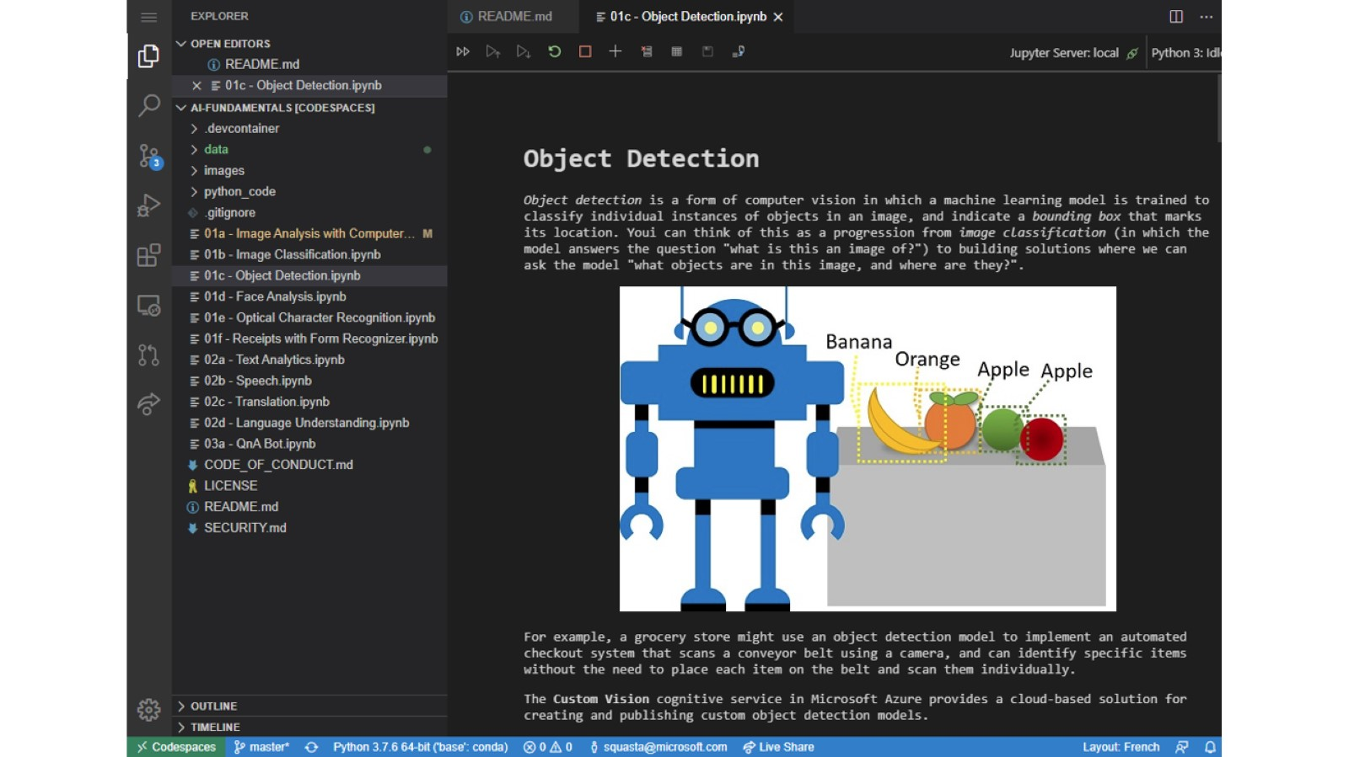

Slide 43
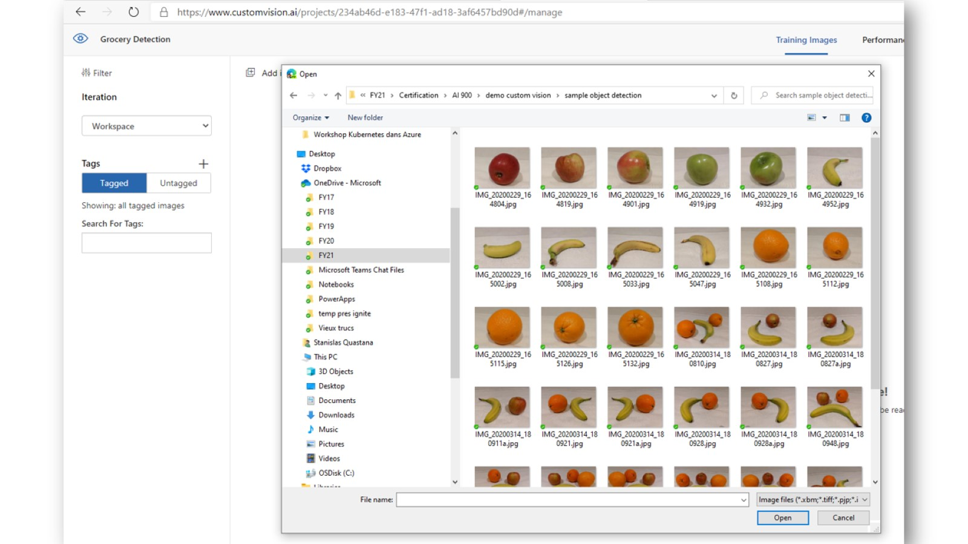

Slide 44
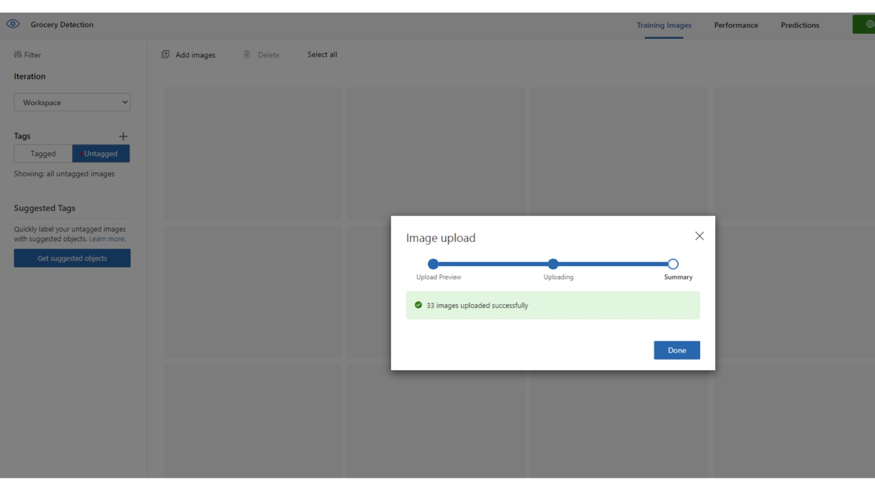

Slide 45
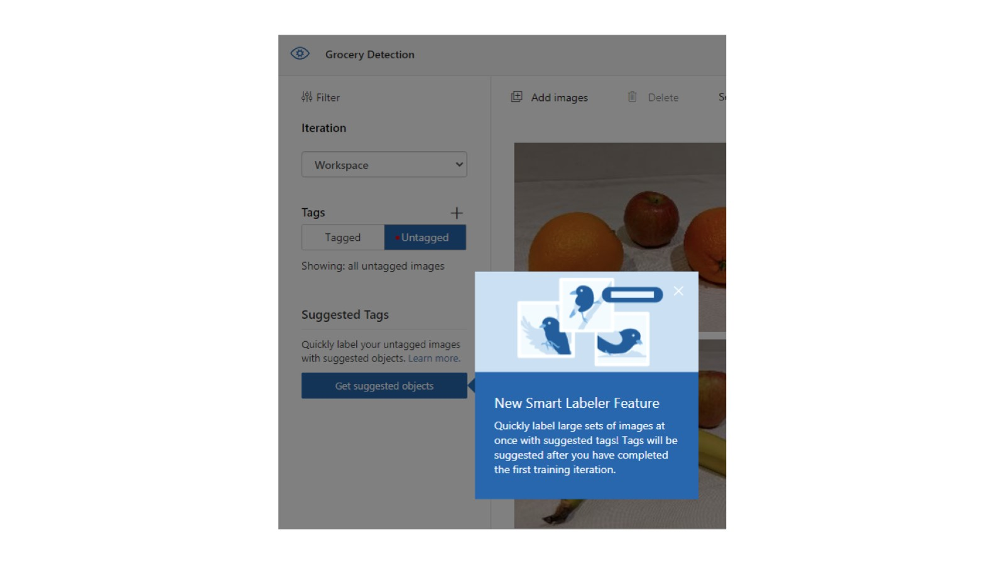

Slide 46
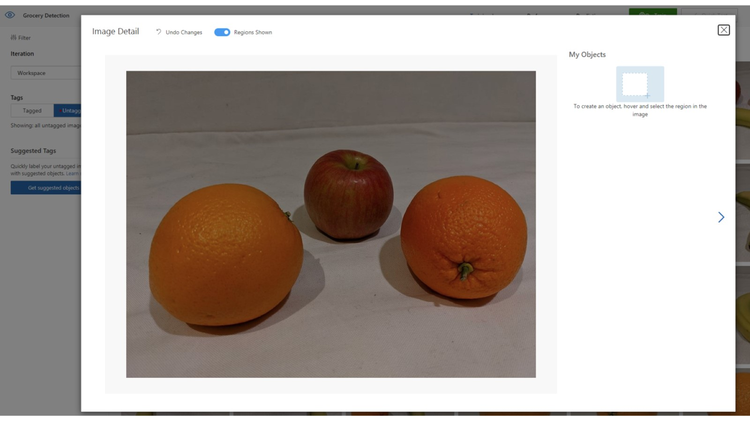

Slide 47
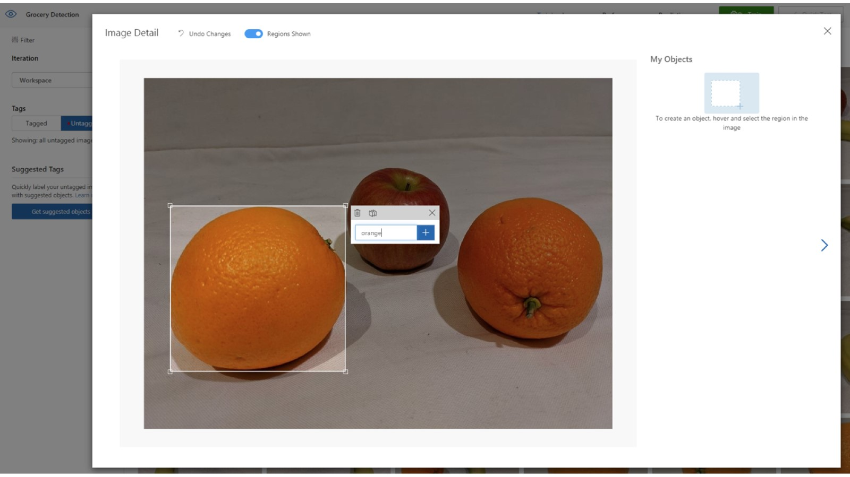

Slide 48
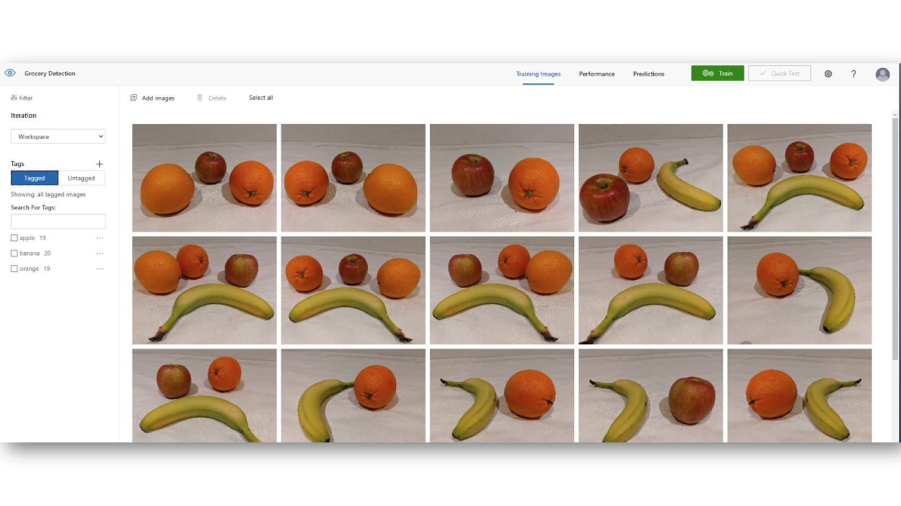

Slide 49
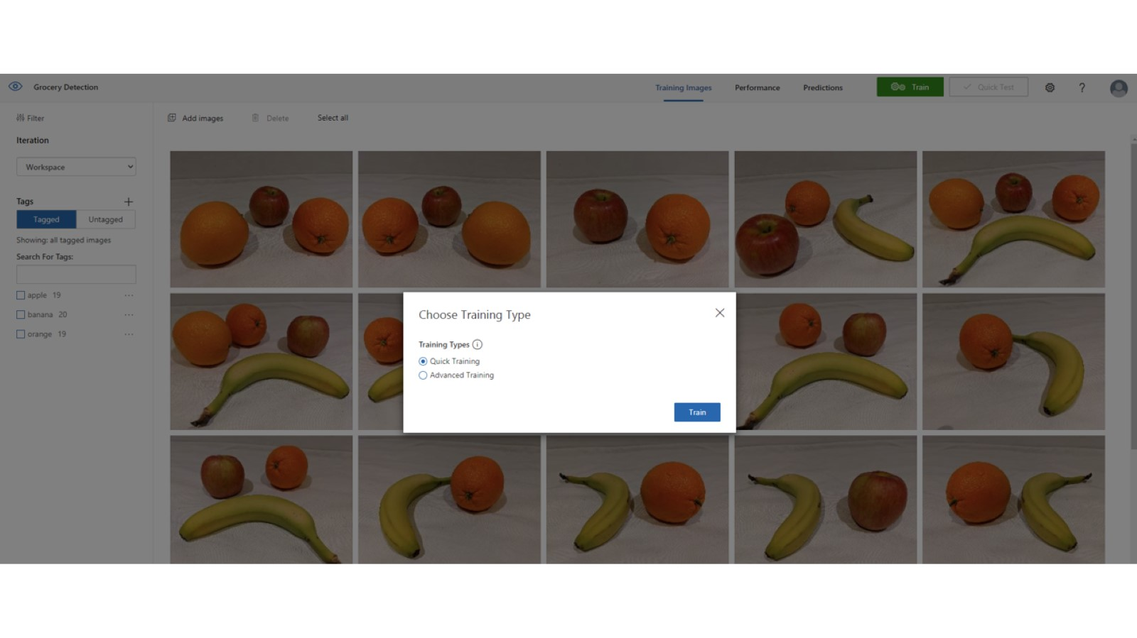

Slide 50
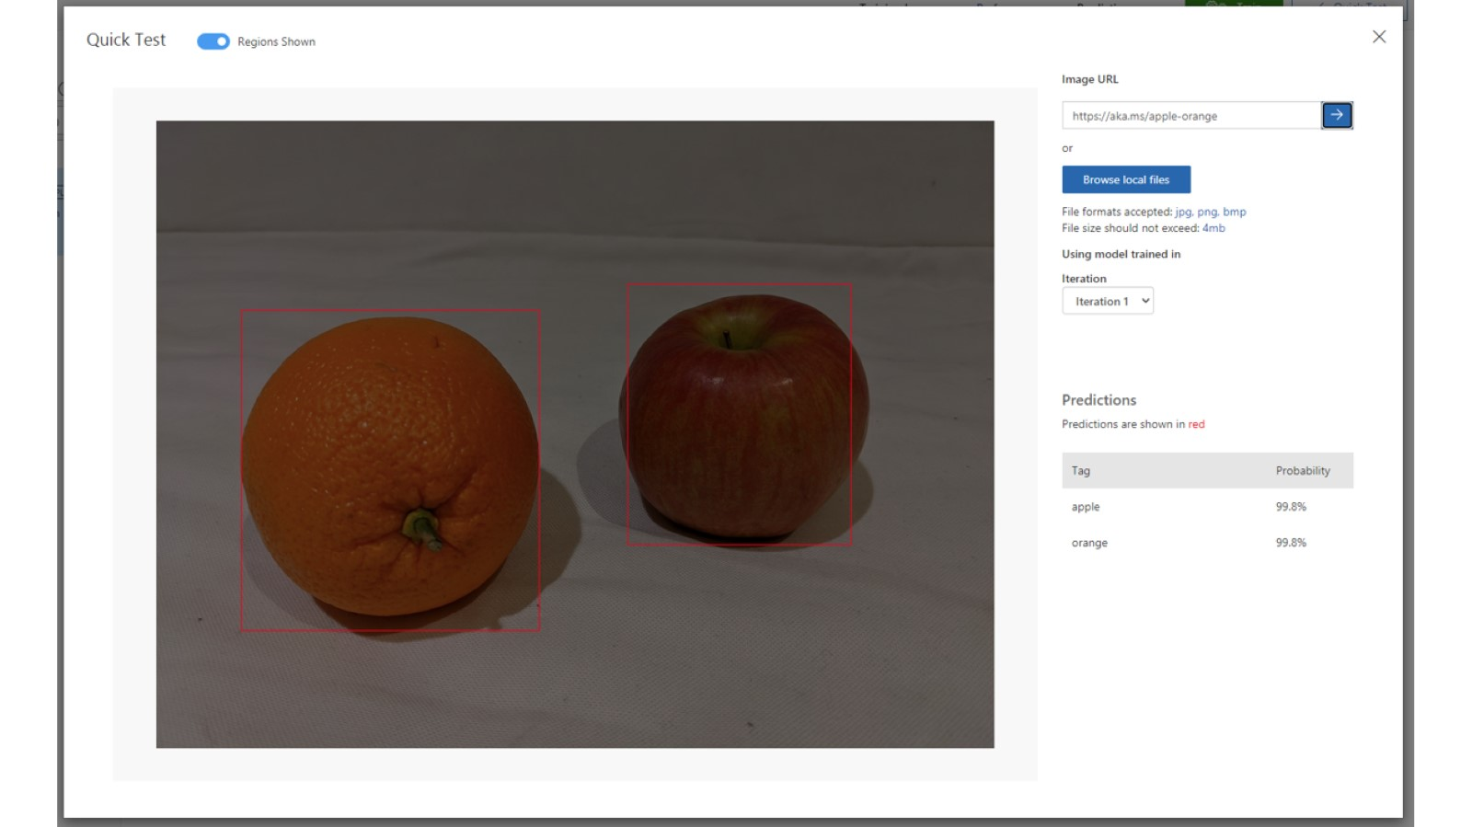

Slide 51
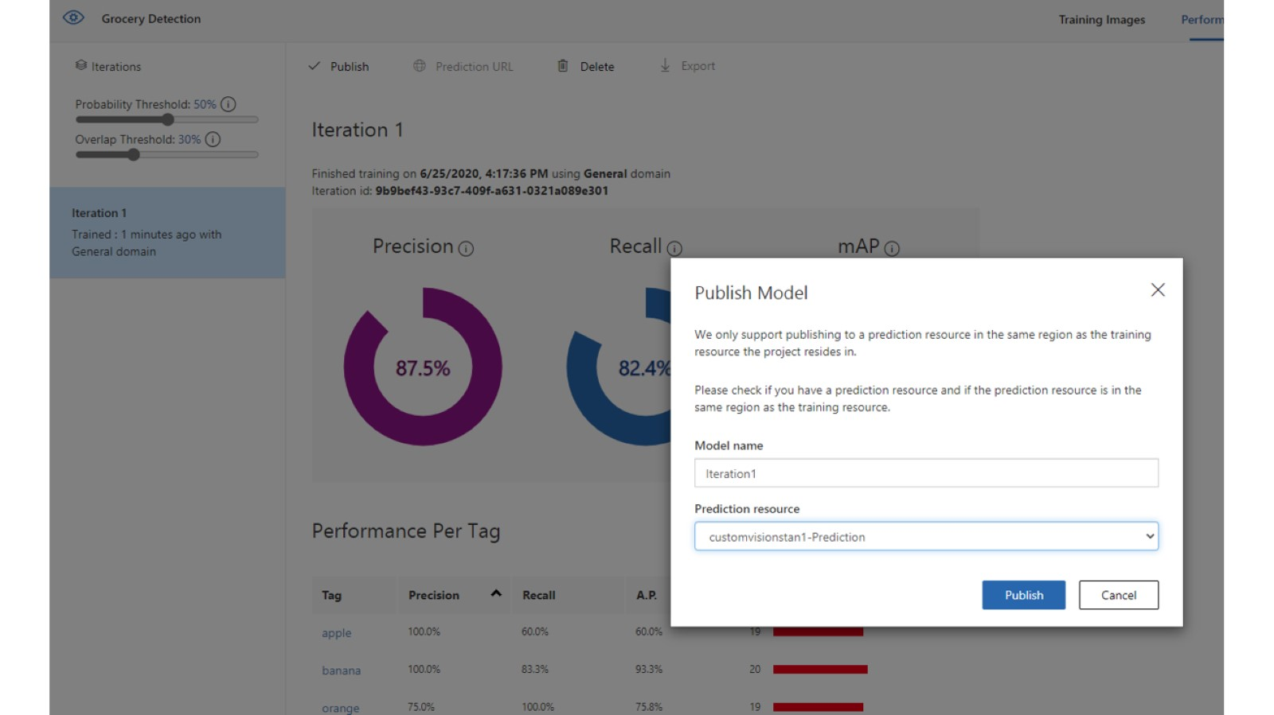

Slide 52
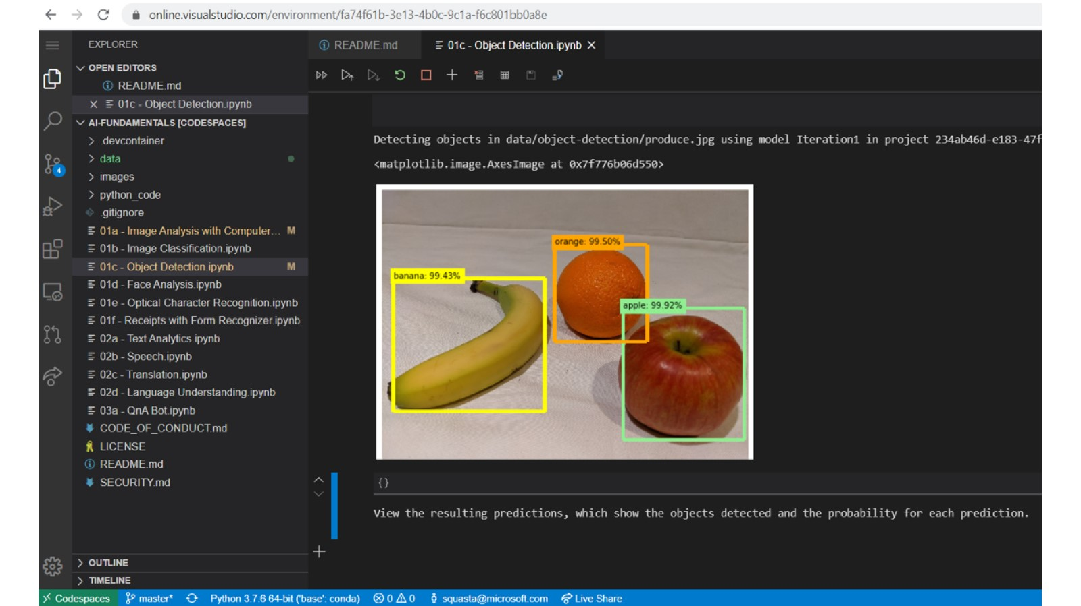

Slide 53

Detect and analyze faces with the Face service

Slide 54

Face detection

Slide 55

Facial analysis

Slide 56


Slide 57


Slide 58

Facial recognition

Slide 59

Uses of face detection and analysis

Slide 60

Detect and analyze faces in Azure

Slide 61

Azure Face Service supports

Slide 62

With Face Service you can also get

Slide 63

Azure resources for the Face service

Slide 64


Slide 65

Read text with the Computer Vision service

Slide 66

Uses of OCR

Slide 67

OCR in Azure

Slide 68

The OCR API

Slide 69

The Read API

Slide 70

The Read API

Slide 71

Analyze receipts with the Form Recognizer service

Slide 72

Azure Form Recognizer

Slide 73

Form Recognizer supports automated document processing through

Slide 74


Slide 75

Using the pre-built receipt model

Slide 76

Free tier for Form Recognizer

